Slide 1

Starter Task
Complete the SDD implementation starter task
Attempt all questions

Slide 2
Learning intentions and success criteria
I am learning…
I can…
About the Testing stage of software development
How to use a test table
About software errors
Use a test table to test a program
Describe and identify different types of errors in software

Slide 3

Testing
N5 - Software Design & Development

Slide 4

Summary
An algorithm is a set of step-by-step instructions for a computer to perform a specific task.
There are three algorithms you need to know in National 5.
Traversing a 1-D Array:
Going through an array one-by-one
Input validation:
Checking a value until it is acceptable
Running total:
Keeping a sum/total as the program runs

Slide 5
Example Program
Line 1 DECLARE bananas INITIALLY 0
Line 2 RECEIVE bananas FROM KEYBOARD
Line 3 WHILE bananas ˂ 0 OR bananas ˃ 10 DO
Line 4 SEND “We have 10 bananas in stock” TO DISPLAY
Line 5 RECEIVE bananas FROM KEYBOARD
Line 6 END WHILE
Line 7 SEND bananas & “ added to basket” TO DISPLAY
What are the acceptable inputs the user can enter?
3
84
-2
0.75
“apples”

Slide 6

Testing
Testing a program is very important as it helps to identify any errors/bugs that had been missed:
It ensures that the program works as expected and solves the problem that was specified
When a program has been implemented test data is created:
Test data is data that is used to fully test that the program works correctly
i.e. what data is accepted? What data is not accepted?

Slide 7
Test Data
There are three types of test data.
Normal
Data that is within range, is the correct data type and should be accepted by the program.
Extreme
Data that is on the boundaries of what is allowed but should still be accepted by the program.
Exceptional
Data that is out of range or the wrong data type. It should not be accepted and often ends in a program crashing.

Slide 8
Example Program
Line 1 DECLARE bananas INITIALLY 0 (INTEGER)
Line 2 RECEIVE bananas FROM KEYBOARD
Line 3 WHILE bananas ˂ 0 OR bananas ˃ 10 DO
Line 4 SEND “We have 10 bananas in stock” TO DISPLAY
Line 5 RECEIVE bananas FROM KEYBOARD
Line 6 END WHILE
Line 7 SEND bananas & “ added to basket” TO DISPLAY
Normal | Extreme | Exceptional
3 | 0 | -4
7 | 10 | 6.23
4 |  | “Mr Wang”

Slide 9
Test Tables
Test tables are used to fully test a program:
Use a combination of normal, extreme, and exceptional data
Compare the expected result to the actual result
Example test table for a program which asks the user to enter a number between 1 and 10:
Test No. | Test Type | Test Data | Expected Result | Actual Result | Test Outcome
1 | Normal | 7 | Accepted | Accepted | PASS
2 | Extreme | 10 | Accepted | Accepted | PASS
3 | Exceptional | “AAAAA” | Program will crash | Program crashed | FAIL

Slide 10
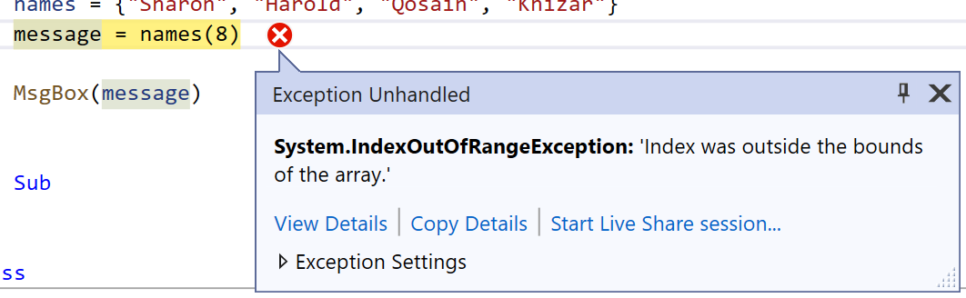
Errors
It is very normal to have errors/bugs in your program:
An essential part of the process to make any program
A vital skill to have is to spot these errors and correct them to fix your code
There are three types of errors you will need to know:
Syntax error
Execution error
Logic error
Often, you will need to spot errors in other peoples’ code:
For example, in your exam

Slide 11
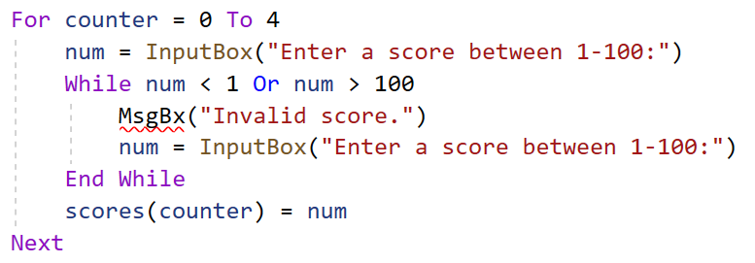
Syntax Error
This is an error in the spelling or grammar used when coding:
A typo in your code
E.g. missing quotations marks, misspelt variable name
Modern programming applications will spot these for you and highlight them to you.
Misspelt “MsgBox”

Slide 12
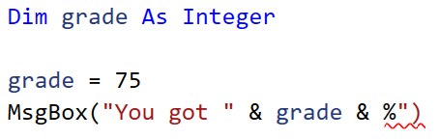
Syntax Error
Another example of this type of error:
Missing quotation marks (“”)

Slide 13
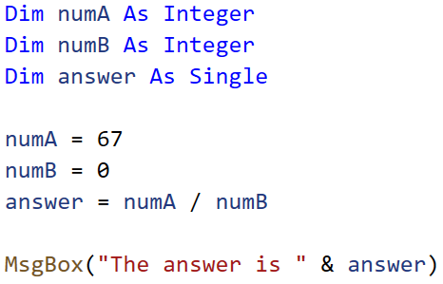
Execution Error
This is an error which will only occur while the program is running:
Also known as a “runtime error”
Happens when the program is asked to do something it can’t
For example:
Division by zero

Slide 14
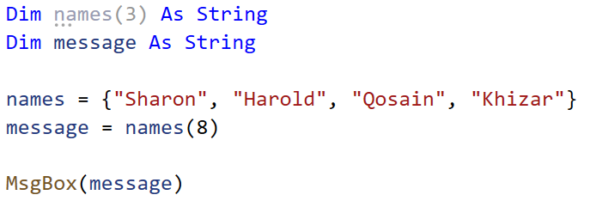
Execution Error
Another example of this type of error:
Out of range

Slide 15
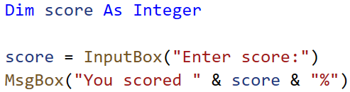
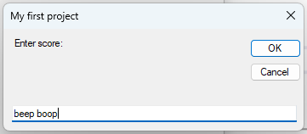
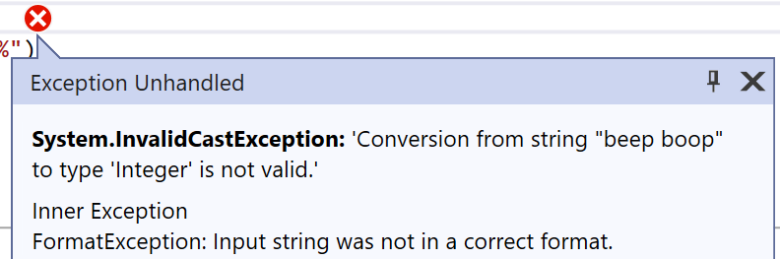
Execution Error
Another common example:
Incorrect data type

Slide 16
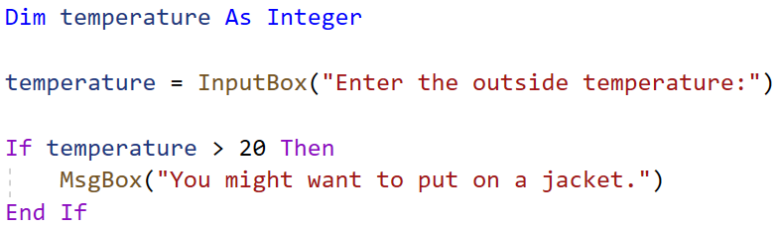
Logic Error
This is an error which is least obvious to see:
The program will run completely fine
There won’t be any crashes or error messages
But you will get unexpected results
Example:
If it’s over 20, wear a jacket???

Slide 17
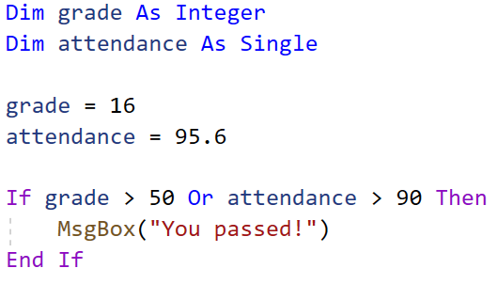
Logic Error
Another example of this type of error:
You should have a good grade AND a high attendance to pass.

Slide 18
Learning intentions and success criteria
I am learning…
I can…
About the Testing stage of software development
How to use a test table
About software errors
Use a test table to test a program
Describe and identify different types of errors in software

